Slide 1
The Upper Farmington River
River Steward Program

Slide 2
A “Wild and Scenic” River
Designated in August 1994 by Congress
14 mile segment from Goodwin Dam to the southern border of the Canton/New Hartford town line, approximately at Bristol Farms on Rte. 44
It is a Partnership River, meaning local governments are responsible for establishing and enforcing zoning regulations. The National Park Service will review proposed projects that require federal permits or funding.
Possesses Outstandingly Remarkable Values (ORVs) – Scenic, Recreation, Wildlife, Fish, Historical
The Farmington River Coordinating Committee (FRCC) oversees and coordinates activities on this segment

Slide 3
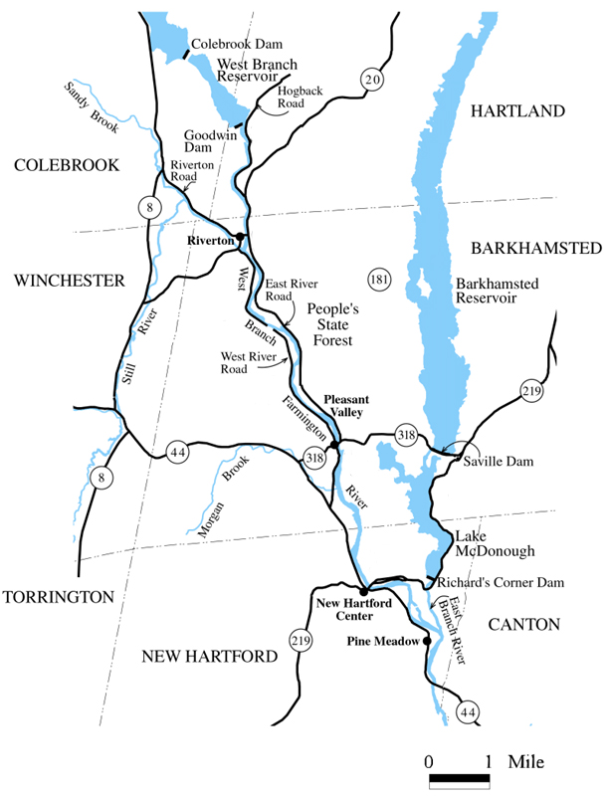
Map of the Upper Farmington River

Slide 4
The Farmington River Coordinating Committee
Mandated by the Wild and Scenic Rivers Act of 1968
Mission is to promote the long term protection of the Upper Farmington River
The FRCC is made up of representatives from the following towns: Hartland, Barkhamsted, Colebrook, New Hartford, Canton – and from the following organizations: DEEP, FRWA, MDC, FRAA, NPS
The River Steward Program is administered under the supervision of the FRCC

Slide 5
Creation of the River Steward Program
Began as a study of river traffic and how users interact in 2014
A part-time River Steward was hired in the fall of 2014 to provide summer management and year-round staff support
In the Summer of 2015, the program expanded to bring on paid and volunteer Assistant Stewards during the busy months of June through August

Slide 6
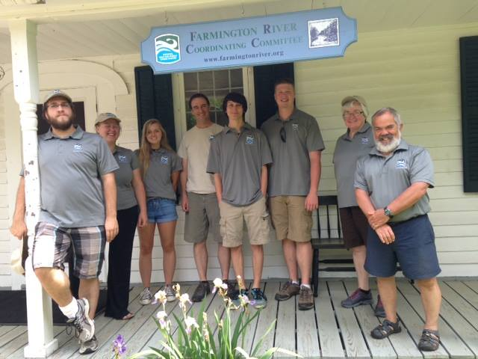
The 2016 River Steward Team

Slide 7
Goals of the Steward Program
Education and Outreach
Enlist recreational users to become stewards of the river
Provide information and guidance to those visiting the river
Establish a vibrant online presence with websites and social media
Model for proper etiquette on the river
Educate about “No Glass, No Trash” and “Pack out what you pack in”
Attend local events with show booth
Keep the river clean

Slide 8
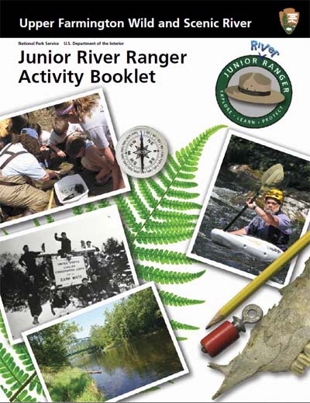
FRCC/Steward Programs
JUNIOR RIVER RANGER
Engage young children
Teach them value of river and stewardship
Earn badge and certificate

Slide 9
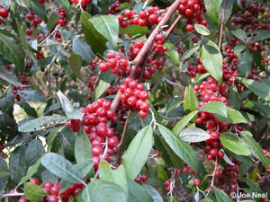
Programs (con’t)
INVASIVE PLANT MANAGEMENT
Work with the FRCC’s invasive team
Cut, pull, burn
Track progress
Autumn Olive

Slide 10
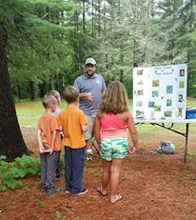
Programs (con’t)
STEWARD EDUCATIONAL SERIES
Lectures on topics related to a steward’s area of interest or expertise
Started in summer 2016
Fishing, Birding, Edible Plants and Camping

Slide 11
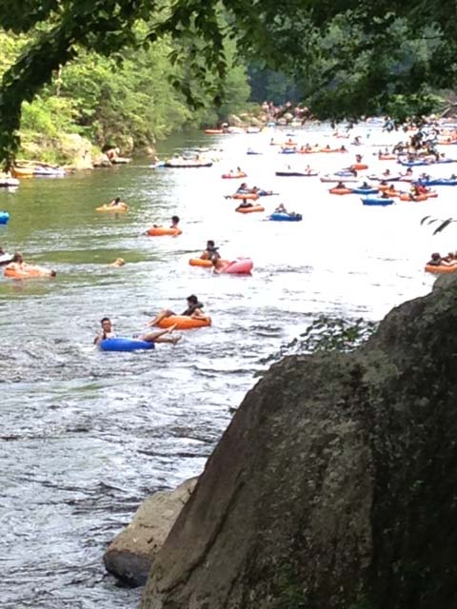
User Groups on the River
Fishermen
Tubers
Boaters
Picnickers
Swimmers
Hikers
Bikers

Slide 12
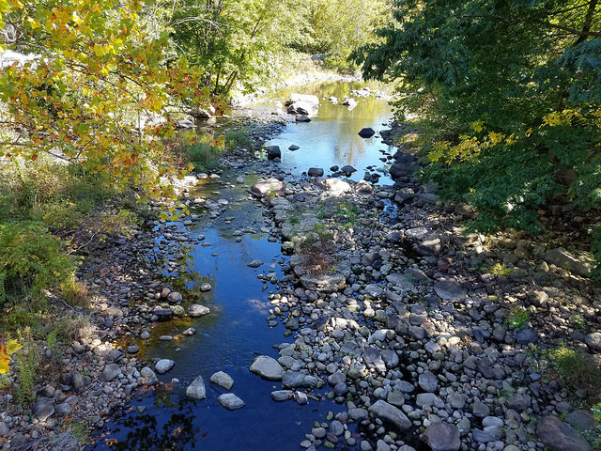
Challenges
Trash
Invasive Plants
Didymo
Runoff Pollution
Proper Buffer Zones
Program Awareness

Slide 13
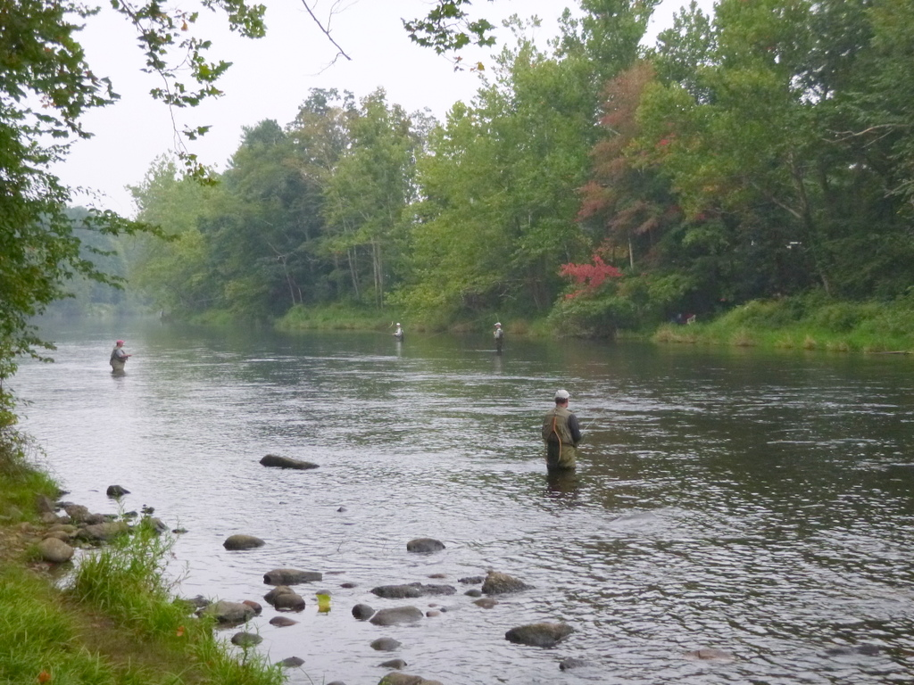
Local Organizations Promoting River Stewardship
Farmington River Watershed Association
Farmington River Anglers Association
Barkhamsted Historical Society
Barkhamsted Recreation
Friends of American Legion and People’s State Forest
Department of Energy and Environmental Protection

Slide 14
Get Involved – Volunteer and/or become a River Ambassador
There are several ways you can help the Farmington River:
We are always looking for volunteers to help keep sections of the river clean, assist with invasive plant removal, represent the FRCC with a booth at local events, and join the summer steward team
Don’t have time to volunteer? Be a River Ambassador by practicing ‘No Glass No Trash’, report anything odd you see on the river, being a role model on the water, and keeping some of our flyers on hand if you own, or work at, a local business.
To learn more visit – FarmingtonRiverSteward.org

Slide 15
The Future
Increase Steward Team presence during the summers
Stewards spending more time engaging users on water via kayaks
Increasing the interaction with users through social media, talks/presentations and educational videos
Protecting and restoring river banks
Engaging youth through the Junior River Ranger Program and Barkhamsted Recreation Camp
Continuing the fight against Invasive Plants

Slide 16
